Slide 1


PRESENTATION
COMPASS MARITIME SERVICES LLC : VALUING SHIPS
ISHANK SETHI
KRATI BAKLIWAL​
POORNASAI BHASKAR
LATIKA GURUNATHAN
MIRUDULA MURALIDHAR​
PREM KUMAR BALAKRISHNAN
STAT-610-674 - FA 23-24

Slide 2
ABOUT US
Leader in marine solution and services . Our primary areas of expertise include executing environmentally conscious ship recycling and demolition services, performing accurate vessel price valuations, and facilitating the smooth purchase and sale of ships.
Ship Transactions
Vessel Price Valuations
Recycling and Demolition
ensuring a smooth process for both buyers and sellers
To create your own, choose a topic that interests you.
To create your own, choose a topic that interests you.

Slide 3
BET PERFORMER
Burmeister & Wain (B&W) 6S70MC engine
Age: 11-years (built in 1997 in Japan)
DWT: 172,000 Tonnes
Nine holds and hatches
Capesize Index: 12,479 (May 2008)
Some other Factors

Slide 4


SHIP VALUATION
The maritime sector are analysed while accounting for a number of crucial factors, including:
Age of the vessel: determines the durability in all aspects by compared to others.
Resale Value: It determines the estimated worth of the vessel in future.
Operational History: The operational condition of the ship is a significant factor in its valuation.
Price: Price is often a crucial factor in determining market value.
Condition: Thorough evaluation of maintenance, structure, and operational efficiency.

Slide 5


We used a statistical method known as linear regression to forecast the ship's cost.
PREDICTING THE PRICE OF THE SHIP
We employed the One Variable Method and the Multi Variable Method as our two approaches to using linear regression for price prediction.

Slide 6
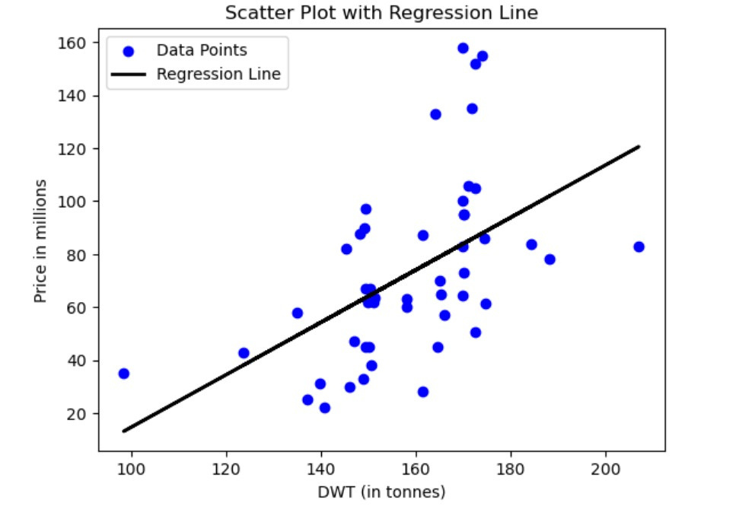
LINEAR REGRESSION ESTIMATED PRICE
After comparing the ship's price to the factors such as Age at Sale, DWT, and Capesize Index, we discovered that:
Age at Sale: As a ship ages, its value decreases by about $4.2 million annually.
DWT: The ship's price rises by $0.98 million for every unit increase in DWT.
CapeSize: The cost of the ship rises by $0.004 million for every unit increase in CapeSize.
DWT to Price Linear Regression Line

Slide 7
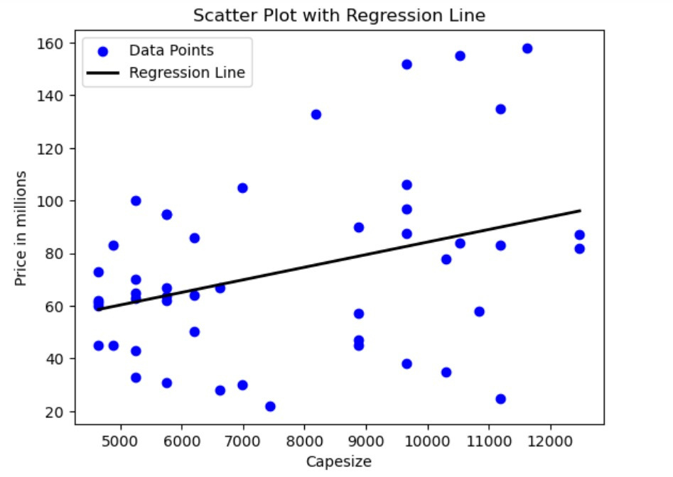
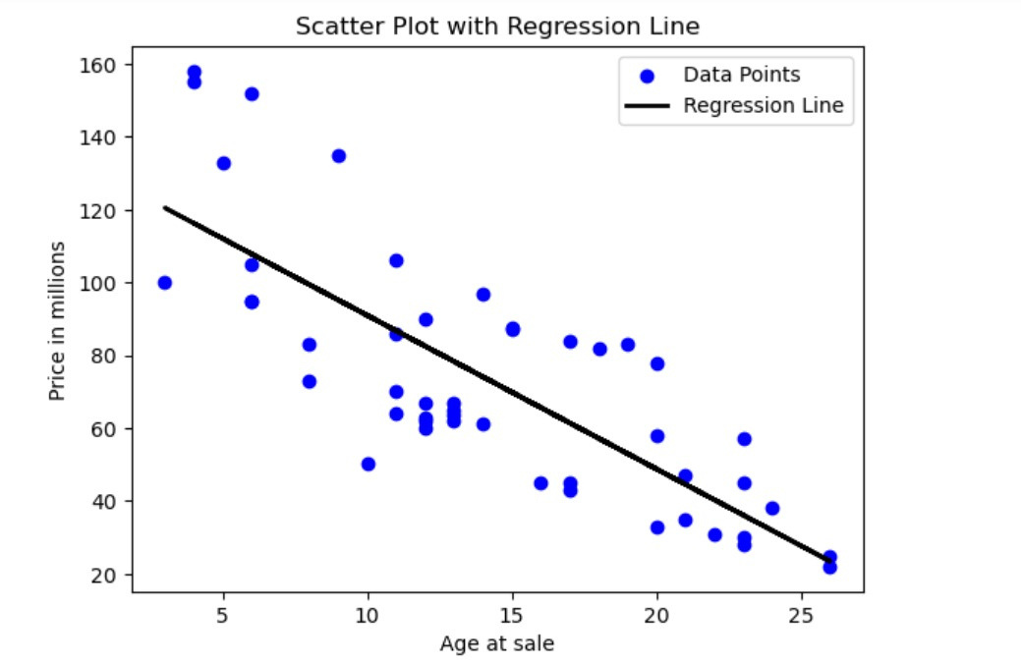
Cape size to Price Linear Regression Line
Age to Price Linear Regression Line

Slide 8
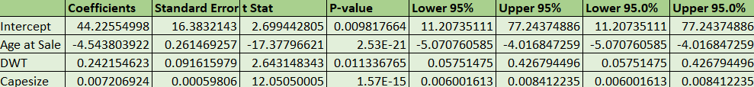
MULTIPLE LINEAR REGRESSION
According to the Regression model, age, DWT, and capsize could account for 91.5% of the variation in ship sale prices.
According to the Regression model, age, DWT, and capsize could account for 91.5% of the variation in ship sale prices.

Slide 9
RELATION BETWEEN VARIABLES
Single Variable Analysis Against Sale Price (y) | Age of sale | Dwt | Capsize
Intercept | 133.12 | -84.16 | 36.43
Correlation | -0.78 | 0.51 | 0.35
Standard Error | 7.58 | 38.81 | 15.03
Coefficient | -4.21 | 0.98 | 0.0047
R-Square | 0.62 | 0.26 | 0.12
Adjusted R-Square | 0.61 | 0.24 | 0.105
Sale Price (without error) | 86.82 | 84.4 | 87.22

Slide 10
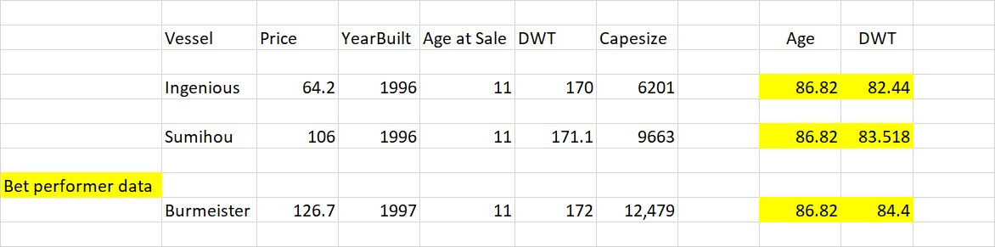
WHICH IS THE BEST COMPARABLE SHIP ?
•Each feature was compared to the respective feature of Bet Performer and the difference was calculated. By the Below Formula.

Slide 11

RECOMMENDED PRICE
We have determined a recommended price of $126.54 million for the "Bet Performer" after performing an in-depth evaluation that takes into consideration significant variables like age at sale, deadweight tonnage (DWT), cape size, location, and dynamics market.

Slide 12
PRICE PREDICTION FROM REGRESSION MODEL
Attribute Variable | Equation to calculate price
AGE
Price = -4.21(Age) + 133.13
DWT
Price = 0.98(DWT) - 84.16
CAPE SIZE
Price = 0.0047(Capesize) + 28.57
Price = 44.22+ (-4.21(Age)+ 0.24(DWT)+0.007*(Capesize))
AGE, DWT, CAPE SIZE

Slide 13

PRICE PREDICTION
Condition | Input Variables | Predicted Price(In Million USD)
5 years younger | Age = 6, DWT = 172, Capesize = 12479 | $
20 k DWT lighter | Age = 11, DWT = 152, Capesize = 12479
30 % Lower charter rate | Age = 11, DWT = 172, Capesize = 8735 | $147.59
Age = 6, DWT = 172, Capesize = 12479
$147.59
Age = 11, DWT = 152, Capesize = 12479
$121.74
Age = 11, DWT = 172, Capesize = 8735
$100.33

Slide 14
PRICE RECOMMENDATION AND SUGGESTIONS
Based on our analysis, we believe the estimated price of the ship should be $126.54 Million with a standard error of +/- $9 Million.
The client needs to consider elements such as Ship Maintenance (both body and engine), the current location of the ship, its capesize during the transaction, market dynamics at the time of the deal, repair costs for any damages, and port charges.
Alternatively, should the market decline and ship prices decrease, we'd advise the client to consider scrapping the ship and selling its individual parts. In certain markets, this method could potentially yield higher returns.

Slide 15

THANK YOU
We look forward for your feedback

